Slide 1
Driving simulator
Presented by:
1)Dinesh B K (1CR17TE009)
2)Bhim (1CR17TE008)
3)Sarumadhi Shivamani (1CR16TE027)
4)Jayanth K (1CR17TE014)

Slide 2
Problems with Traditional Approach
Driving simulator are very expensive .
Driving school that have car driving simulators as a means to teach its customers. Often bought by economically “big” schools investing too much on the product.
Cars are a liability and high cost to maintain.
As we can see in amazon products that sell simulators costing from Rs.25,000 upto Rs.3,00,000 alone.

Slide 3
Existing solutions and its drawbacks:
The cost of making a homemade simulator takes money and also resources to set up[1].
The making of “world’s simplest simulator” is quite not easy to set and also required a pre built set up simulator[2].
The total setup of making the entire project is very straight forward like rest of the simulators but very very sophisticated[3].
The models software looks old and unrealistic[4].
Similar projects have been done by many other by taking steering wheel as important aspect, whereas this project will eliminate its subtly[5].
The project where i took inspiration from was well done. But didn’t involve any hardware to produce the result[6].
Another version of this was implemented but lacked the quality of controlling the car because of constraints on not able to handle acceleration or brake[7].
The proposed solution of the author only works and won’t be accurate to be able to produce the simulation[8].

Slide 4
Objectives
The previously proposed solutions have been having one or the other constraints on making the working possible. For example with using no hardware but completely software run program won’t provide the stimulus of a driver for the person experiencing the driving simulator.
And using the certain hardware required has produced undesired results of unable to control the car properly and in other cases requiring to use costly hardware to achieve this.
On the other hand most of the projects are unable to create models to provide cost efficiency. Which is taken into primary importance in our project.

Slide 5
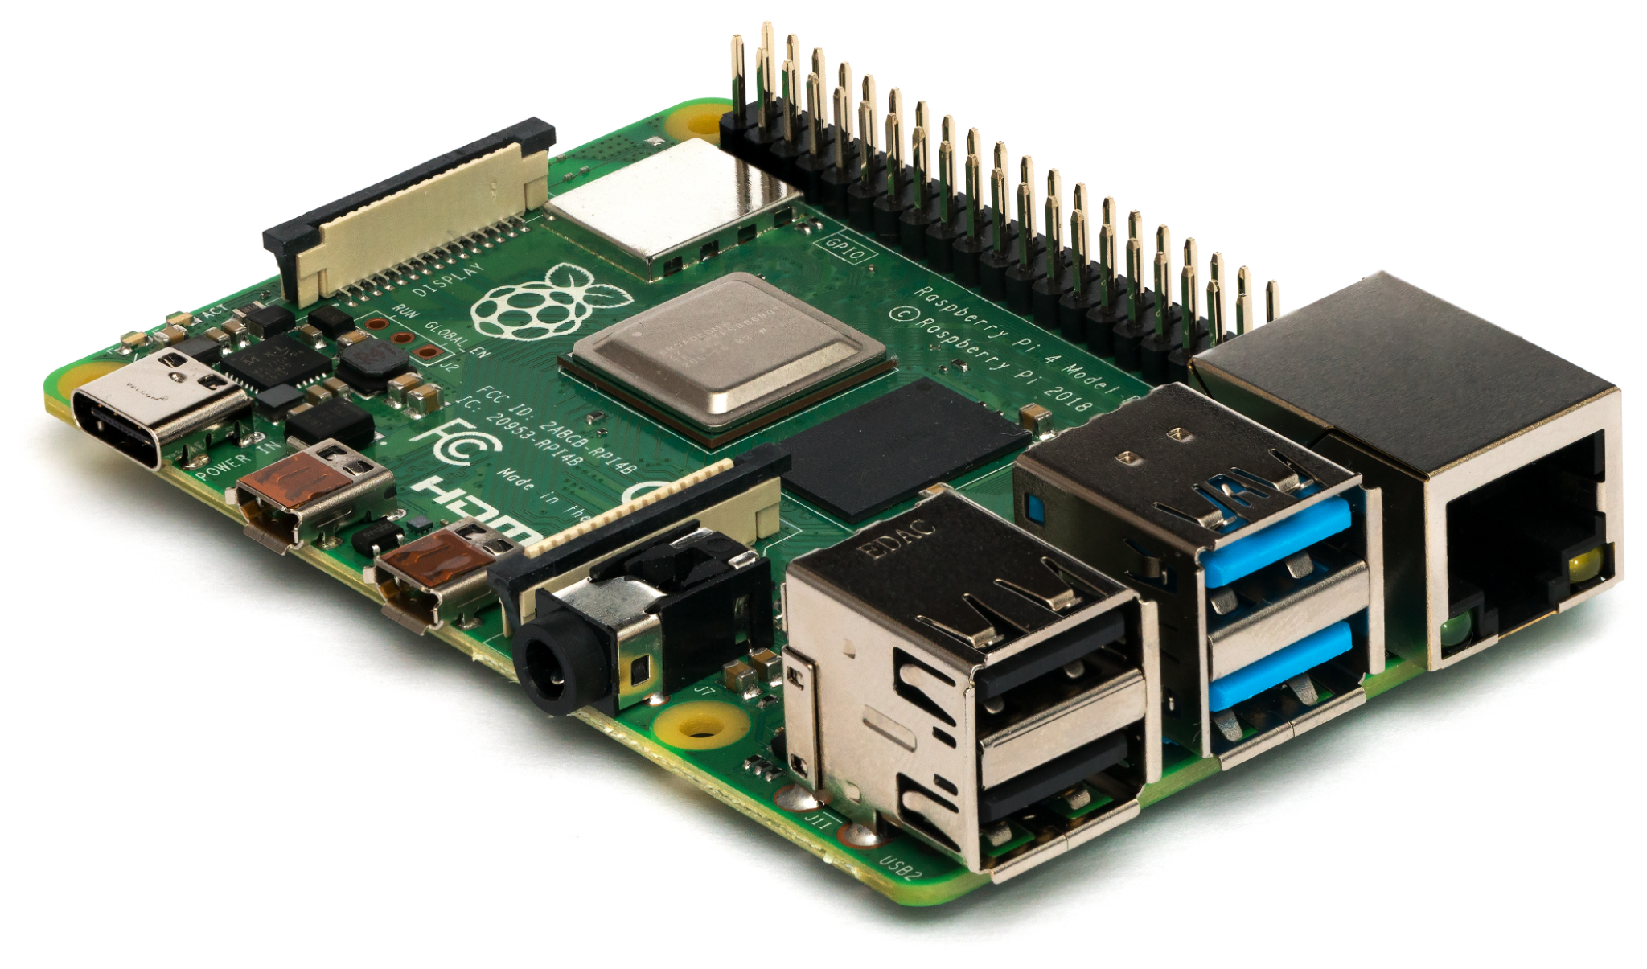
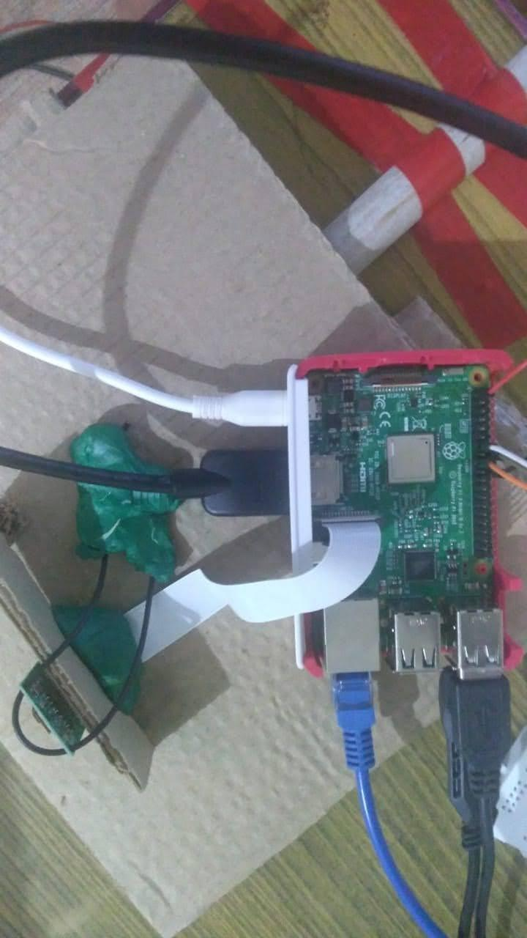
Components required
Raspberry pi

Slide 6
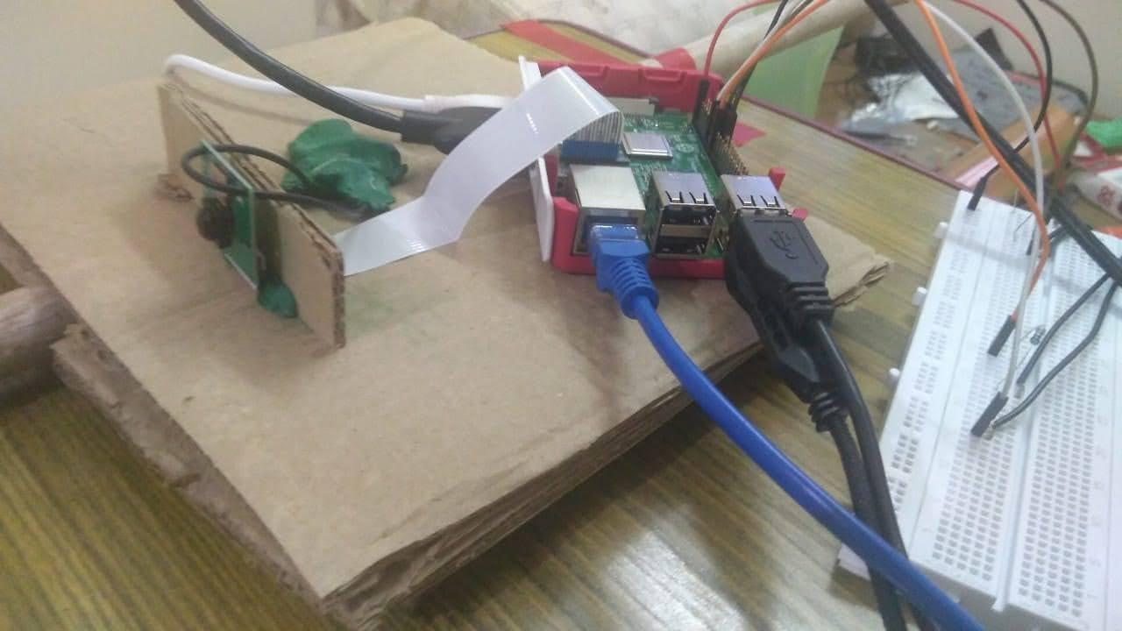
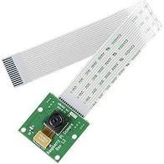
Raspberry pi, 5MP camera module

Slide 7
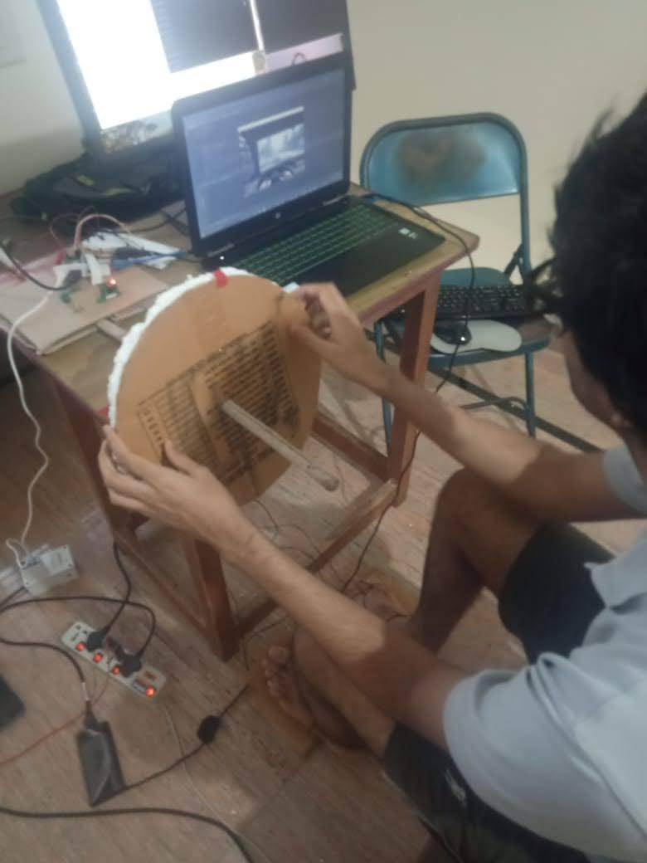
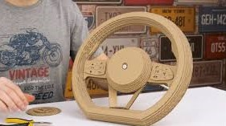
Cardboard cutout for steering wheel

Slide 8
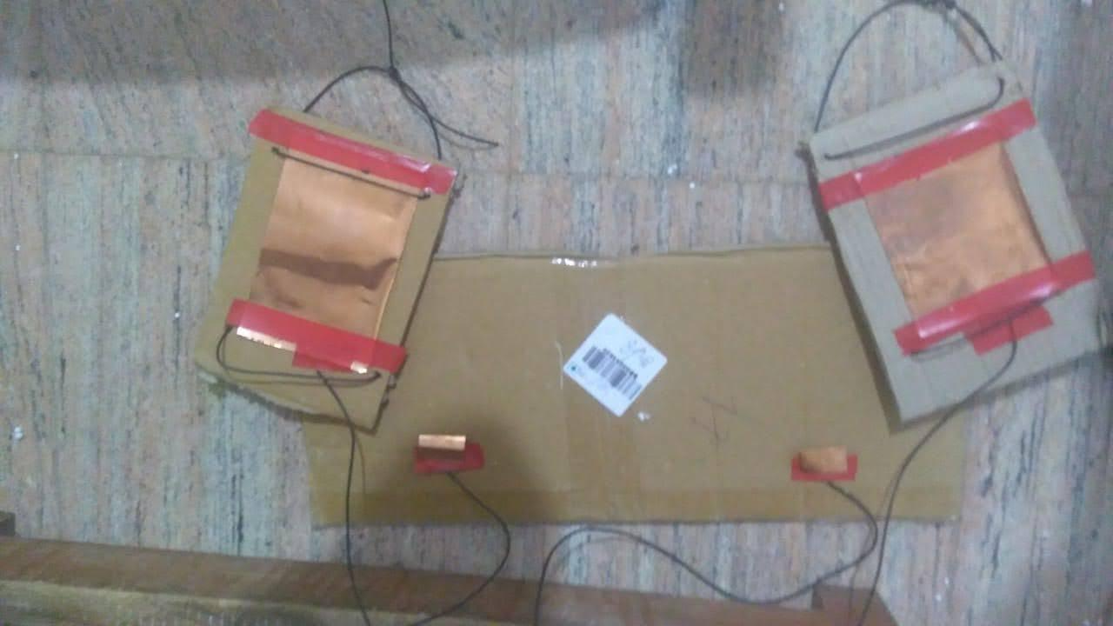
Cardboard cutout for pedals

Slide 9
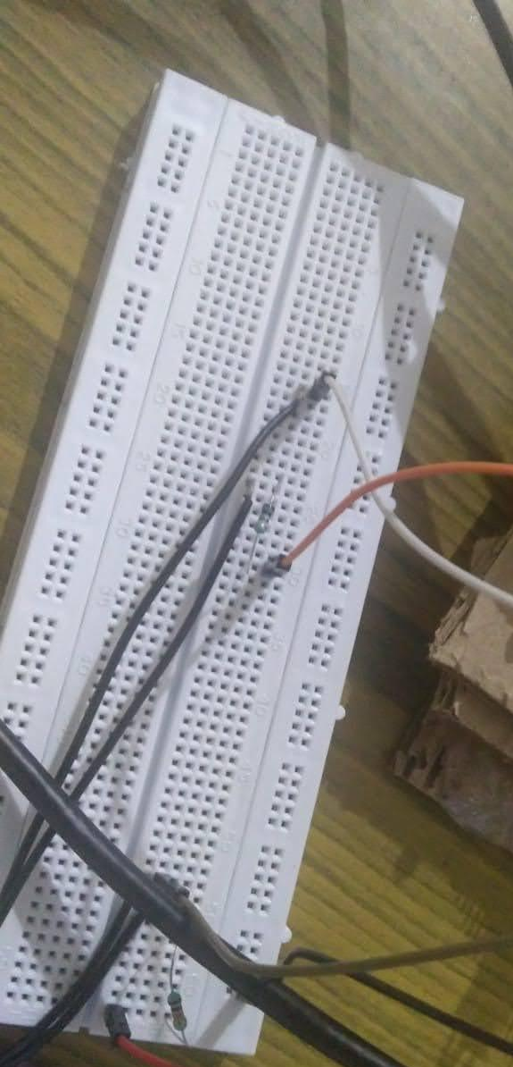
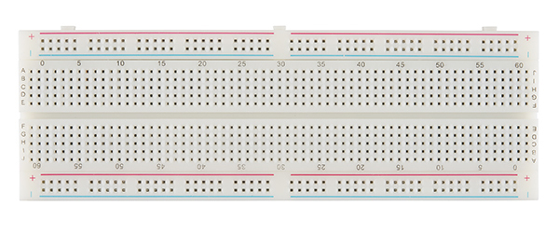
Breadboard

Slide 10
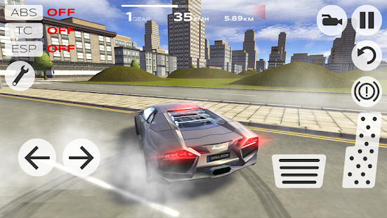
A car simulator game or software installed in a pc

Slide 11
Simulation tools
Python 3.7, jupyter and pycharm IDE
imutils library package
opencv,numpy package
Driving simulation software for demo

Slide 12
Working
On first step we use imutils package to video stream input frame by frame from Raspberry pi 5MP camera module.
And then using opencv package we use it to input direct key emulation to keyboard press from each frames that was obtained from video stream.
By the above operation we could steer the car in simulation.
By using potentiometer and by placing that in a pedal which is cutout from the cardboard. We can accelerate and use brakes.
The next slide will show the pictorial representation.

Slide 13
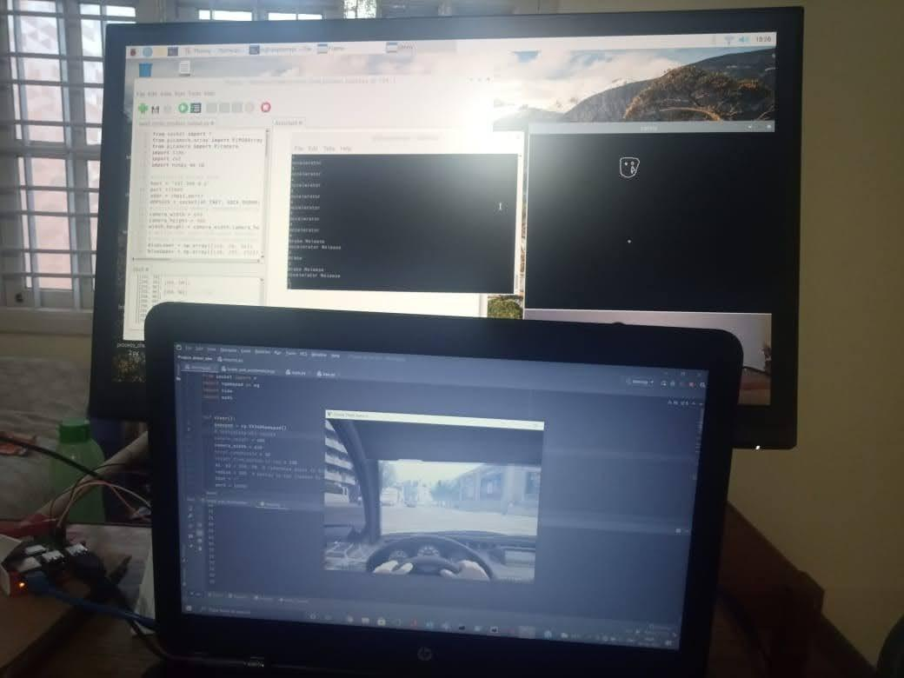
Progress with opencv: directions control

Slide 14
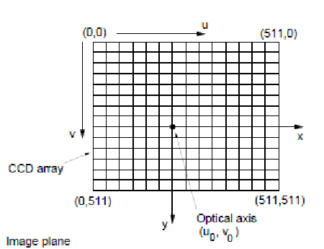
Capturing center coordinates of closest circle from previous circle and sending them to server

Slide 15
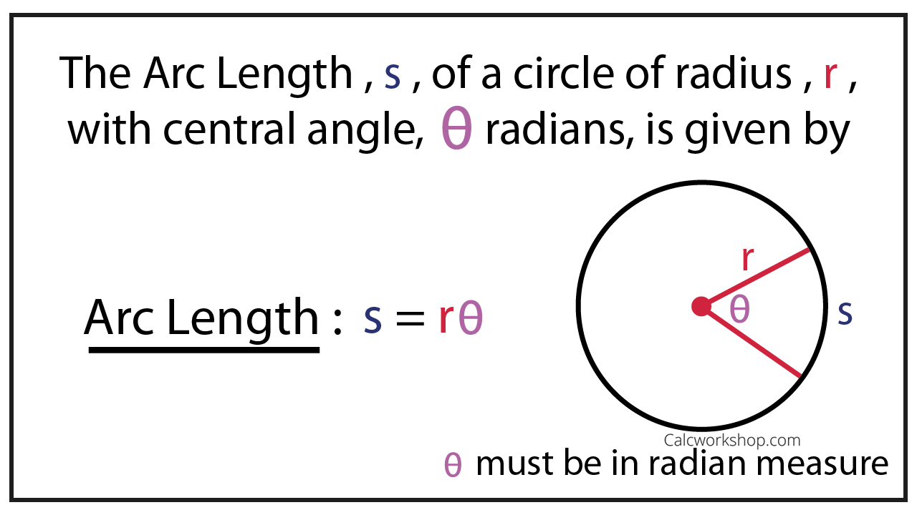
This is to decide the direction of car from the received coordinates: Explanation---

Slide 16
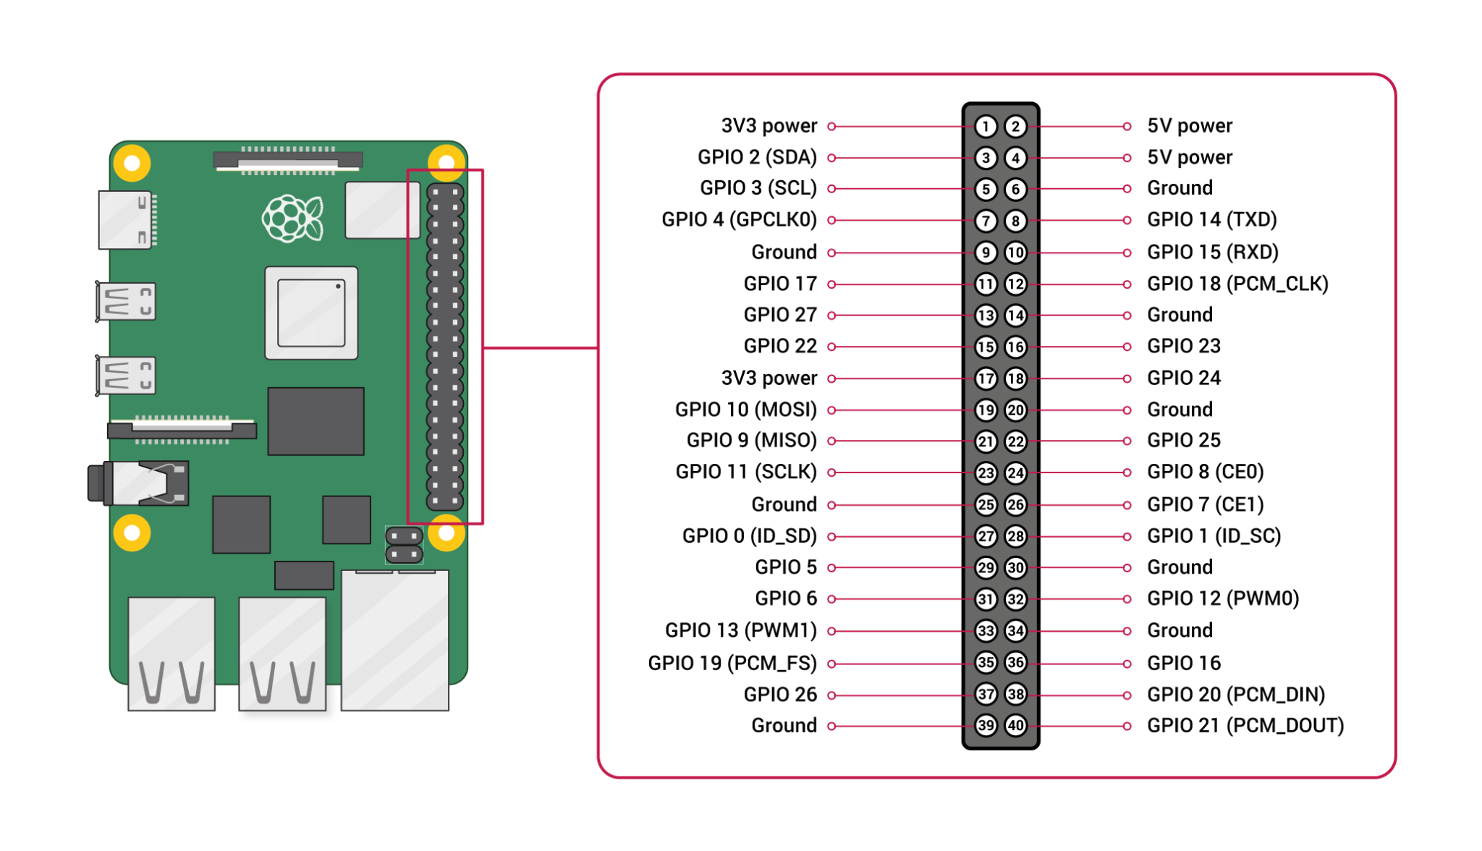

Slide 17
References
[1] Thomas, “Homemade driving simulator by Thomas”, https://www.pinterest.com/pin/412431278369257871/
[2]Jeff, “World's Simplest DIY Sim Racing Rig”, https://www.youtube.com/watch?v=78jAn6fixk8
[3]Dipl.-Ing. Philipp Wintersberger, “Driving Simulator (Hexapod)”, https://www.thi.de/en/research/carissma/laboratories/driving-simulator-hexapod
[4] Romesh Khaddar, “Driving Simulator Project”, https://www.nevadadot.com/home/showdocument?id=9077, pg 7

Slide 18
[5]John Taylor, germano, James Silva , “SmoothStep force feedback steering wheel”, https://hackaday.io/project/44385-smoothstep-force-feedback-steering-wheel
[6]Patel Digant, “gesture-gaming-python”, https://github.com/pateldigant/gesture-gaming-python
[7]abhisavalya, “opencv_controller”, https://github.com/abhisavaliya/opencv_controller
[8]Roshan Chavan, Vishwajit Nimhan, Siddesh Katkar, Nikil Rai , “Multi-Platform Car Game Contoller and Driving Simulator”, Pg 1740 - Pg 1742 https://www.irjet.net/archives/V5/i2/IRJET-V5I2379.pdf

Slide 19
Thank you

